Slide 1



Reconstructing the Real Chirp of the MARSIS Radar
Madeline Hart
Mentor: Stefano Nerozzi
Institution: University of Arizona

Slide 2
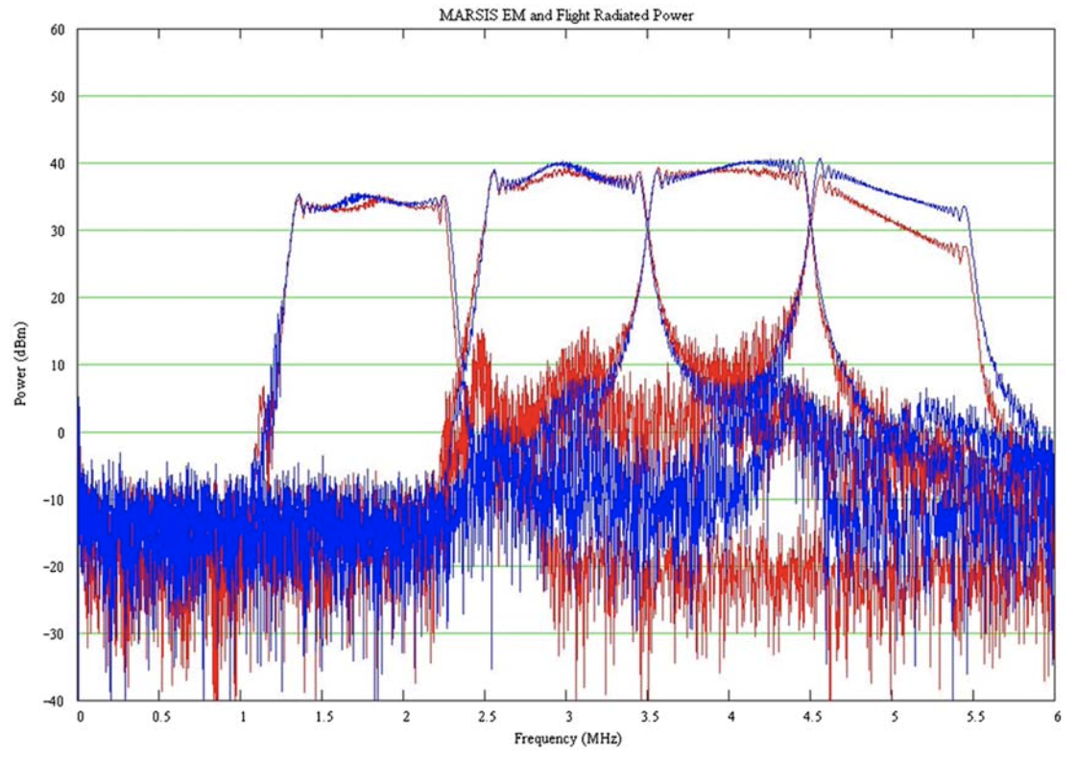
What is MARSIS?
Mars Advanced Radar for Subsurface and Ionosphere Sounding
Subsurface Sounding
  Transmits frequency modulated radar chirps
    Four frequency bands from 1.8MHz to 5MHz
  Signals reflected from Mars are used to find subsurface reflectors
Source: Jordan et al. (2009)
Notes:
Add figure from Jordan et al paper

Slide 3
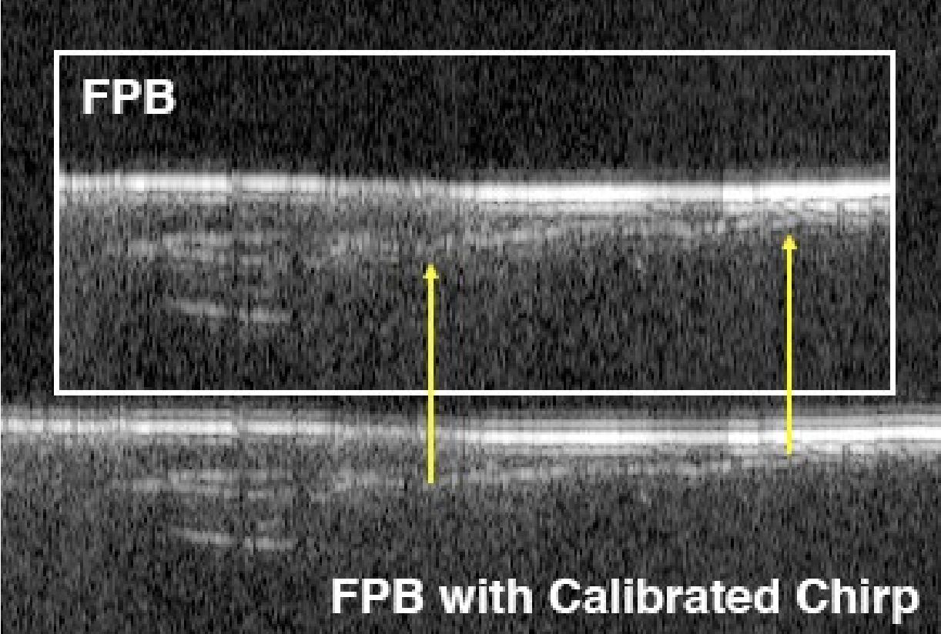
Problem: characteristics of sounding bands are unknown
For all sounding bands, the power spectrum of the signal is unknown
Present solution: use the physically ideal case of a perfect chirp function
  Assumes a perfectly linear rate of frequency change from beginning to end of frequency band
  Allows for some level of analysis, but leaves door open to missing information
SHARAD
  Another subsurface sounder: radargrams seen below
Source: Planetary Data System, Bruce Campbell
Notes:
Add sharad radargrams from Planetary Data System

Slide 4
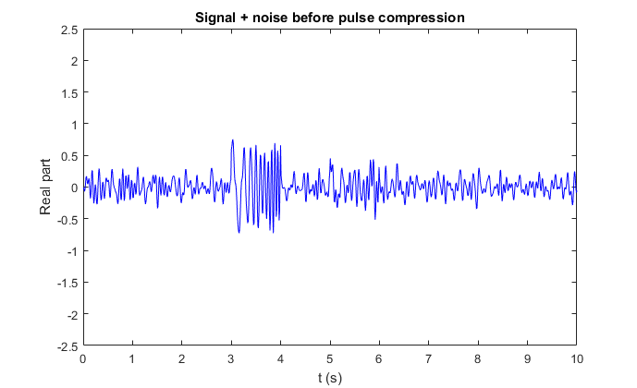
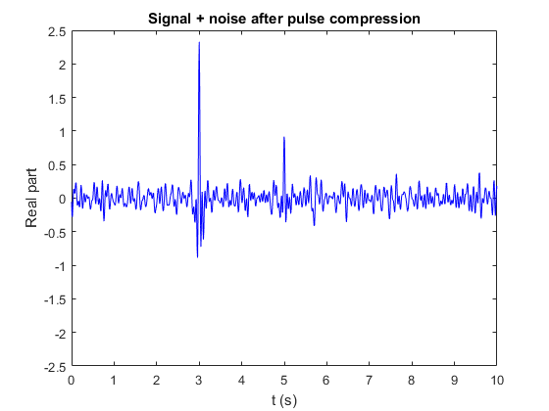
Pulse Compression
Process to increase resolution of MARSIS return signal
Involves convolution of transmitted data with received data
  Pulse compression algorithm is presently weak due to unknown transmission
  The shape of the signal (power spectrum) is unknown
Source: Wikipedia
Source: Wikipedia
Notes:
This can be cut if need be
Add compression image from wikipedia where echo is hidden in noise

Slide 5
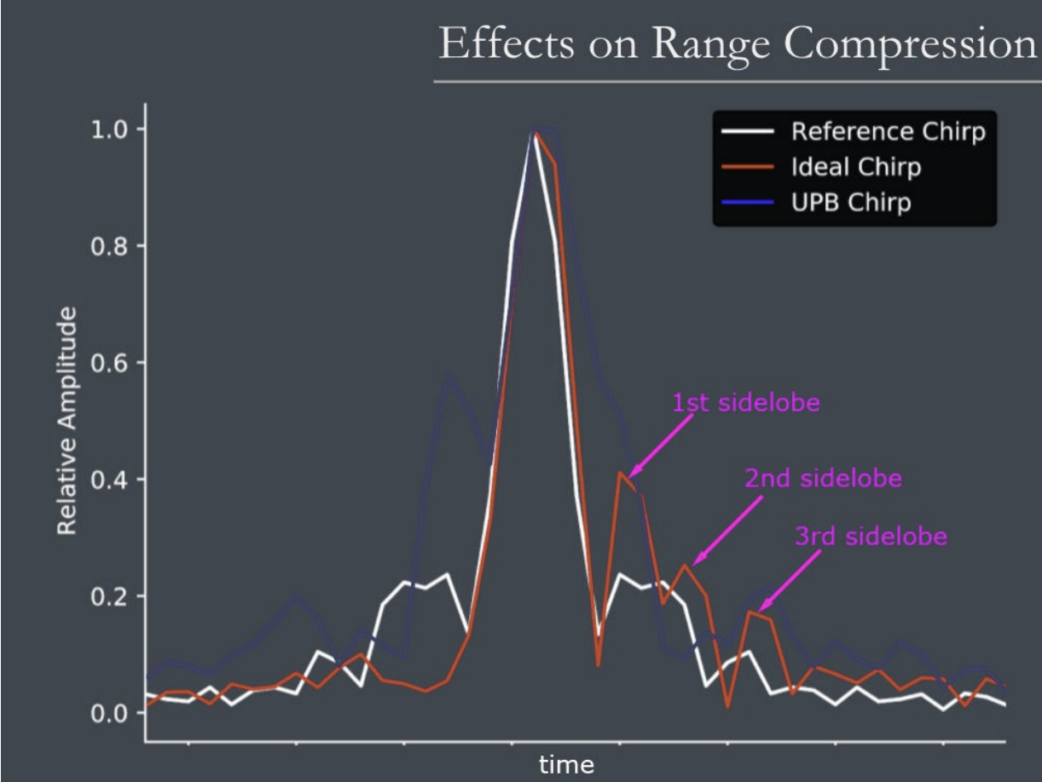
What we know
“Ideal” shape of the pulse after compression
Favorable characteristics for radargram resolution
  Symmetry
  High-power main lobe
  Equalization (symmetry) of side lobes
There exists some window function which defines the power spectrum of the MARSIS transmitted chirp
Source: Planetary Data System, Matthew Perry
Notes:
Add sharad picture of ideal vs real pulse compression. Emphasize peak power increase and suppressed sidelobe for more radargram feature clarity.

Slide 6
Genetic Algorithm
Mimics natural selection on a population of possible solutions
  Population is a list of polynomial equations
Fitness function parameters based on ideal case
  Symmetry
  Peak power
  Peak resolution
Notes:
Note that the algorithm does not guarantee the optimal solution. Instead it will pick a highly optimized solution.

Slide 7
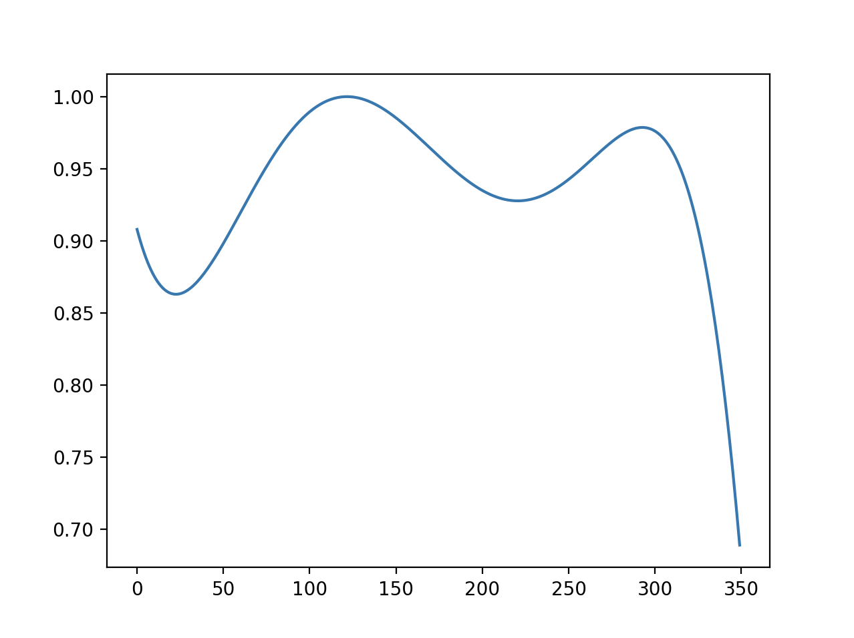
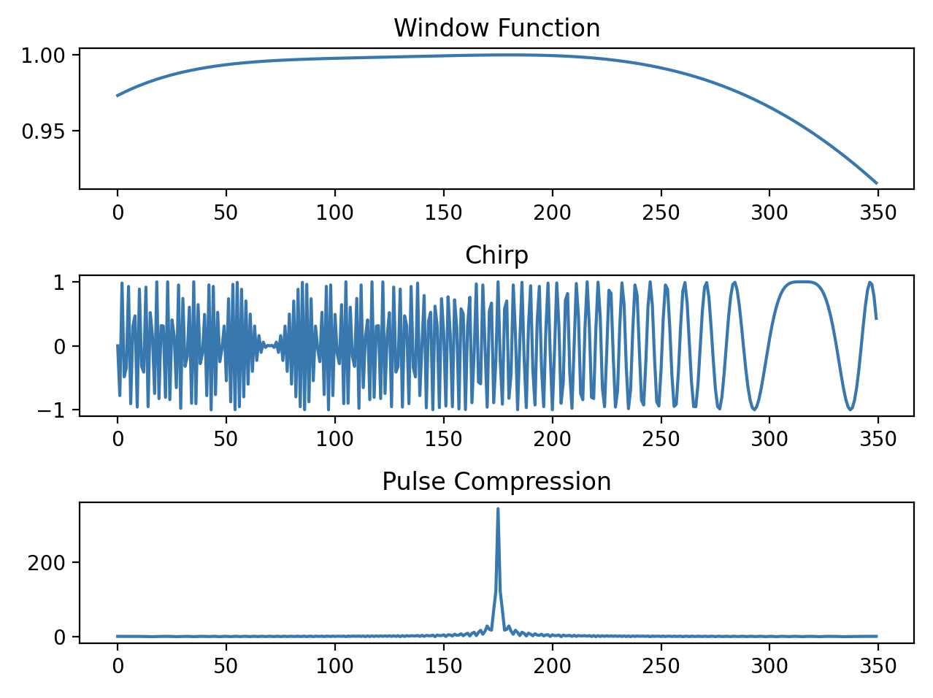
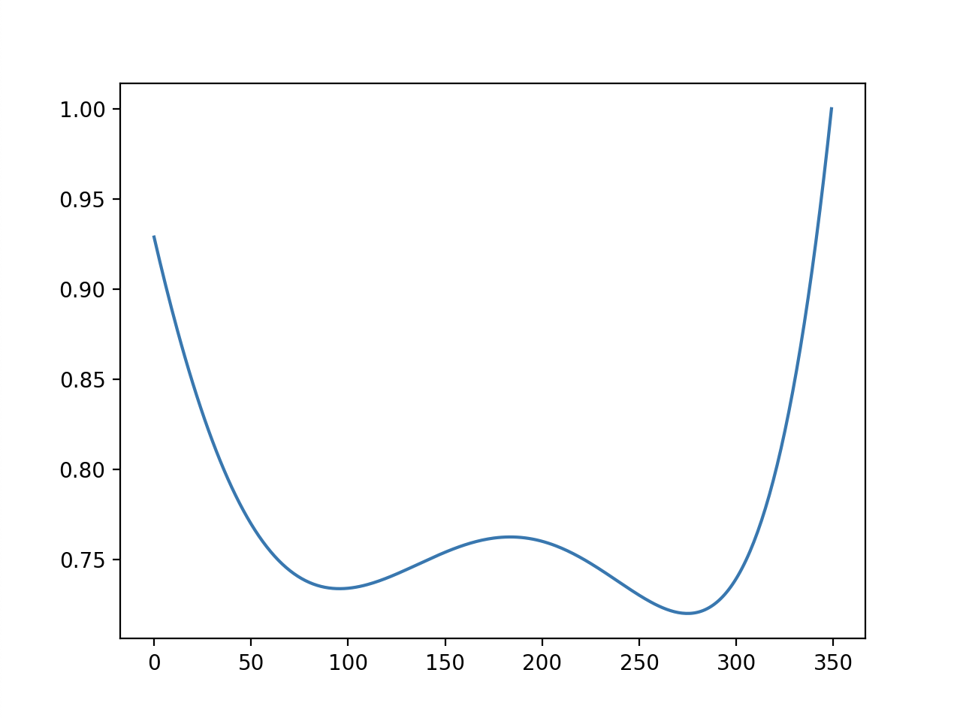
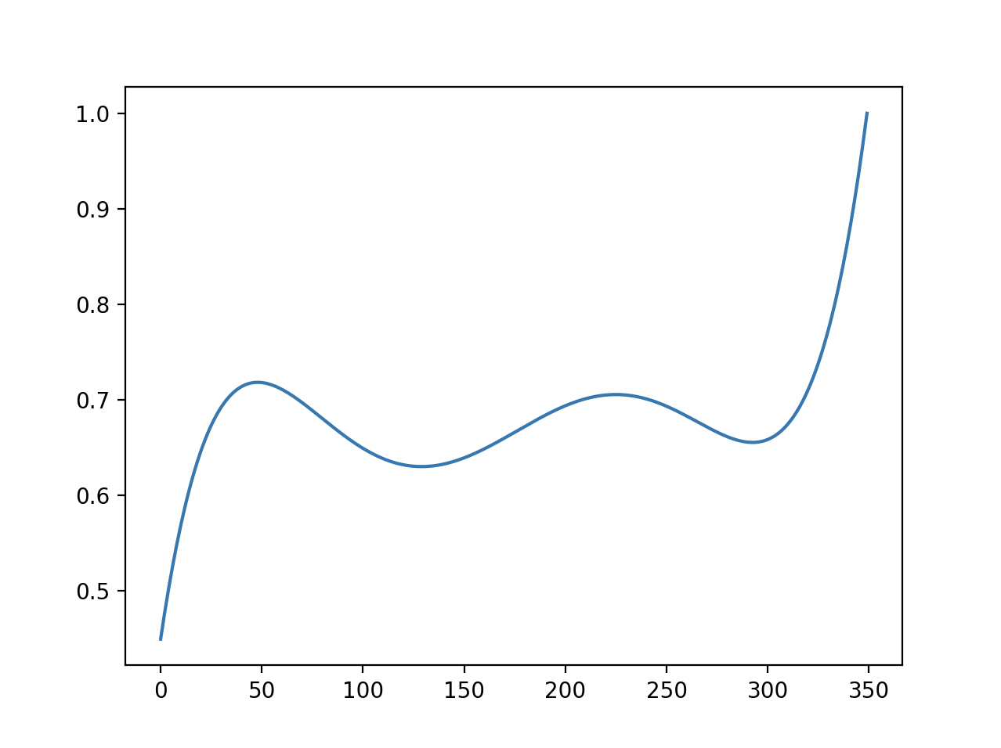
Results
Notes:
Add image of GA used on two ideal chirps convolved together. Explain expectation of a rectangular window function since there is no change between “transmitted” and “received” in GA model

Slide 8
Next steps
Modifying weights on fitness parameters to arrive at more robust solutions more quickly
Finding MARSIS data with minimal interference to run algorithm against
Comparing radargrams for ideal chirps and algorithm-defined chirps for resolution

Slide 9
Thank you

